Slide 1
Personalized Wallpaper suggestion system based on user profile, album preferences, gender, age & emotional status using advanced machine learning techniques.
Presented by,​
Salman F. Rahman (20301273)​
Md. Monjur E Elahe (23141076)

Slide 2
Aim
Introduction
Literature Review
Dataset Analysis
Methodology
Conclusion

Slide 3
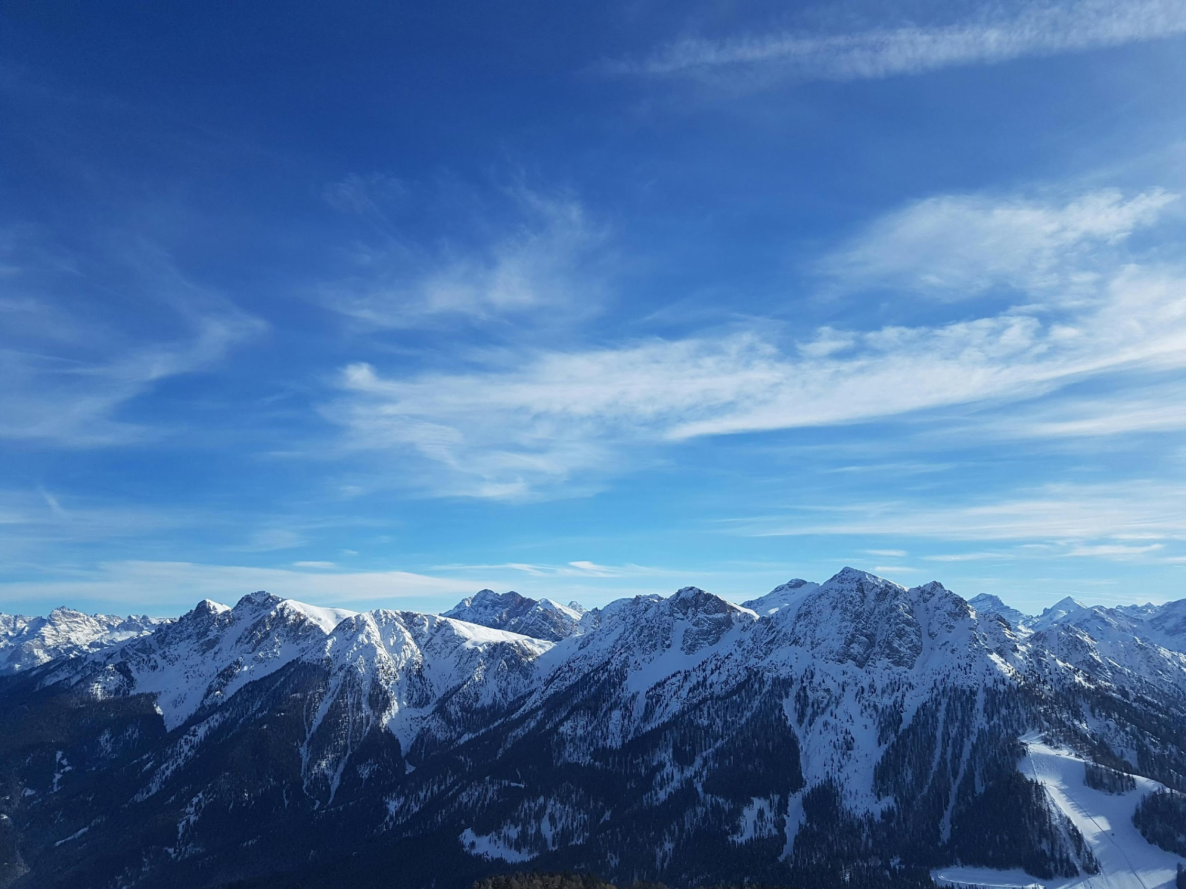
Introduction
To suggest wallpapers tailored to user profiles, preferences, and emotional status.
Approach: Leveraging advanced machine learning for personalized recommendations.

Slide 4
Literature Review:
https://dl.acm.org/doi/10.1145/2396636.2396693
Paper Title: Seamless integration of mobile devices into interactive surface environments
The paper "Seamless Integration of Mobile Devices into Interactive Surface Environments" explores integrating mobile devices with interactive surfaces using depth and RGB cameras. The literature review discusses related work, including touch sensing with depth cameras and object tracking methods. It highlights limitations of existing approaches and emphasizes the need for seamless integration and improved user experience. Key works cited include studies by Wilson, Klompmaker et al., and Schmidt et al. Overall, the review provides context for the authors' work and underscores the importance of their proposed solution.
http://www.ijcte.org/vol11/1237-CT002.pdf
Paper Title: Mobile Phone Background Design for Older Adults: A Case Study of Line
This study investigates how visual characteristics, such as background images, impact the usability of mobile apps for older adults, using the Line messaging application as a case study. The research involved 40 older adult participants in a qualitative observational study over three weeks. Findings indicate that post-training, many participants changed their backgrounds to suit color preferences, mood, or vision needs. While some remained non-adopters, training in app use encouraged senior users to adapt the app to their needs, suggesting that app-specific training could improve senior use of mobile apps. The study underscores the importance of considering visual design elements for enhancing usability among older adult users.
Paper Title: Color-Grayscale-Pair Image Sentiment Dataset and Its Application to Sentiment-Driven Image Color Conversion
https://bright-journal.org/Journal/index.php/JADS/article/view/57
Paper Title: STUDY ON IMAGE CLASSIFICATION METHOD BASED ON SMALL SAMPLE LEARNING
The paper by Dongxue Wang addresses the challenges in constructing effective image classification systems, particularly focusing on small sample learning methods. Wang identifies various issues, including talent recruitment difficulties, declining employment rates in relevant research areas, unclear method positioning, and mismatches between university curriculum and industry needs. The study proposes strategies to address these challenges, emphasizing the importance of talent training, innovation, and personalized classification methods. Overall, the paper provides valuable insights into enhancing image classification methodologies in the context of small sample learning.
https://dl.acm.org/doi/abs/10.1145/3463946.3469240
This paper introduces a Color-Grayscale-Pair Image Sentiment Dataset, which includes discrete and continuous emotion labels for pairs of color and grayscale images. Unlike existing emotion image datasets, this dataset provides valuable insights into the impact of color information on recalled emotions. Analysis of the continuous-valued emotion labels revealed that color images elicit a broader range of positive and negative emotions compared to grayscale images. Additionally, experiments were conducted to transform the color of images based on target emotions, successfully changing the overall color of images according to input emotion values. Another experiment focused on converting emotion categories, demonstrating the ability to generate images that evoke different emotions compared to the original ones. Overall, this dataset and its applications shed light on the intricate relationship between color and emotion in images.
Paper Title: Seamless Background Replacement on Mobile Devices (Liu et al., 2018):
Background replacement allows users to replace the background of mobile photos with a different image while preserving the integrity of the foreground object. Liu et al. propose a deep learning approach utilizing a convolutional neural network (CNN) for accurate foreground segmentation. Unlike traditional methods, the CNN can handle complex backgrounds and challenges like blurry edges and hair removal. The evaluation demonstrates that the proposed method achieves high accuracy in background replacement while maintaining real-time processing capabilities for mobile devices.

Slide 5
We will use CNN for face recognition and sentiment analysis of any walpaper .

Slide 6
Exploratory Data Analysis (EDA)]
Before Data Wrangling:
Overview of raw data sources.
Analysis of user profiles, album preferences, gender, age, and emotional states.
After data wrangling
Insights gained from cleaned and preprocessed data.

Slide 7
Methodology
1. Data Collection: Gathering user profile data, album preferences, etc.
2. Data Preprocessing: Cleaning, transforming, and encoding data.
3. Feature Engineering: Extracting relevant features for recommendation.
4. Machine Learning Models: Training models for personalized recommendation.
5. Recommendation Engine: Deploying the recommendation system.

Slide 8
Partially Working Prototype
Demonstration: Display screenshots or UI mockups of the prototype.
Functionality: Overview of features implemented in the prototype.
Feedback: Initial user feedback and improvements.

Slide 9
Future Steps
1. Model Refinement: Enhancing recommendation accuracy.
2. User Interface Enhancement: Improving user experience.
3. Scaling: Handling larger datasets and user bases.
4. Integration: Incorporating real-time user feedback for dynamic recommendations.

Slide 10
Dataset Analysis
Intel Image Classification
Context
This is image data of Natural Scenes around the world.
Content
This Data contains around 25k images of size 150x150 distributed under 6 categories. {'buildings' -> 0, 'forest' -> 1, 'glacier' -> 2, 'mountain' -> 3, 'sea' -> 4, 'street' -> 5 }
The Train, Test and Prediction data is separated in each zip files. There are around 14k images in Train, 3k in Test and 7k in Prediction. This data was initially published on https://datahack.analyticsvidhya.com by Intel

Slide 11
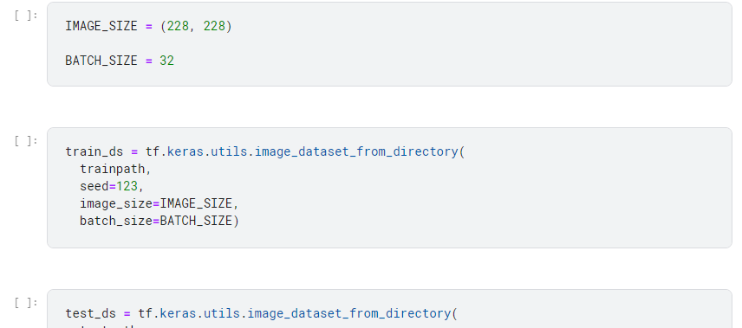
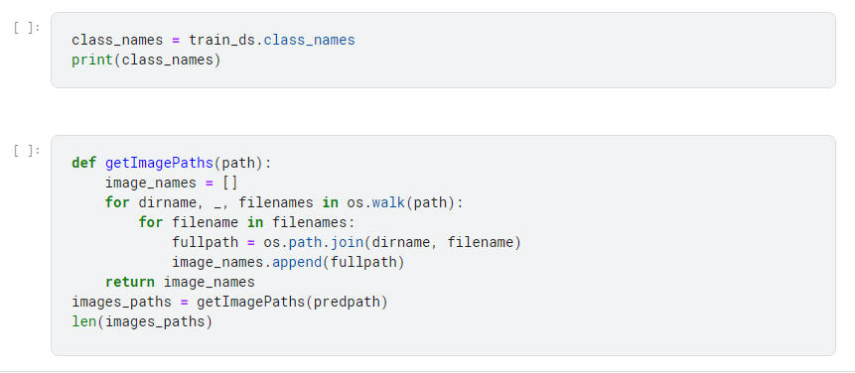
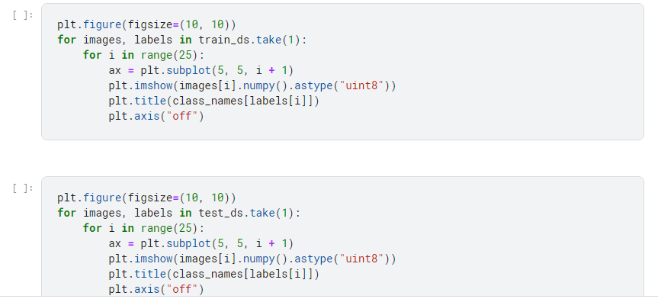
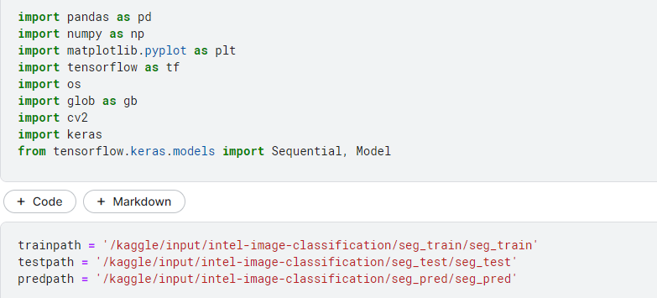

Slide 12
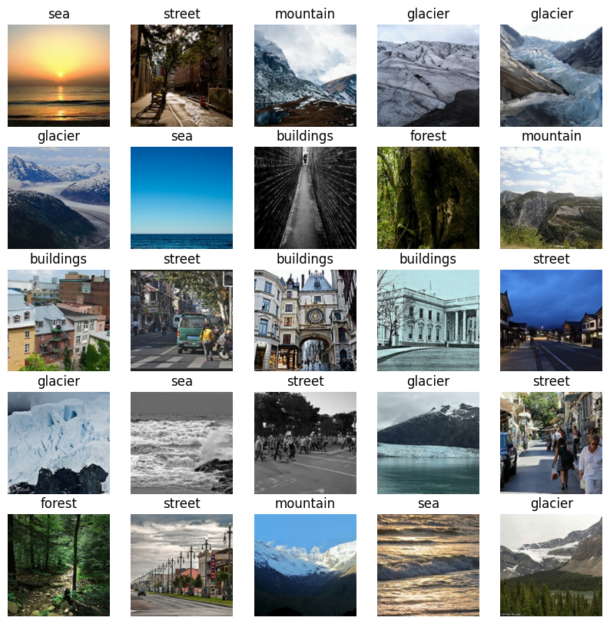

Slide 13
Conclusion
Summary: Developed a personalized wallpaper recommendation system.
Impact: Enhancing user satisfaction and engagement.
Next Steps: Continuous improvement and refinement for optimal performance.

Slide 14
Thank you

